Slide 1
Chapter 12
Styles, Themes, and Master Pages

Slide 2
Styles, Themes, and Master Pages
Styles are part of the Cascading Style Sheet (CSS) standard.
Themes are similar to styles, but apply to the server controls that ASP.NET provides.
Master Pages are “blueprints” for the layout of all child pages.

Slide 3
Styles
Styling can be done in HTML, but leads to cluttered markup.
CSS gives you a wide range of consistent formatting properties that you can apply to any HTML element.
Styles allow you to add borders, set font details, change colors, add margin space and padding, and so on. Many of the examples you’ve seen so far have in this book have used CSS formatting.

Slide 4
Note: CSS “standard”
The CSS standard is not a single, universal standard with complete commonality across all browsers.
It exists in several versions (up to CSS3) and includes features that not all browsers support and features that browsers implement differently.
The site http://caniuse.com is a great resource for figuring out which browser versions support which CSS features, and therefore when it’s reasonably “safe” to use a CSS feature in your website.

Slide 5
Style Types
Inline style:
An inline style is a style that’s placed directly inside an HTML tag. This can get messy, but it’s a reasonable approach for one-time formatting. You can remove the style and put it in a style sheet later.
Internal style sheet:
An internal style sheet is a collection of styles that are placed in the <head> section of your web page markup. You can then use the styles from this style sheet to format the web controls on that page. By using an internal style sheet, you get a clear separation between formatting (your styles) and content (the rest of your HTML markup). You can also reuse the same style for multiple elements.
External style sheet:
An external style sheet is similar to an internal style sheet, except it’s placed in a completely separate file. This is the most powerful approach because it gives you a way to apply the same style rules to many pages.

Slide 6
Basic inline style
<p style="background: Blue">This text has a blue background.</p>
<p style="color:White; background:Blue; font-size:x-large; padding:10px"> This text has a blue background.</p>

Slide 7
Web Control properties are translated to CSS styles
<asp:Label ID="MyLabel" runat="server" ForeColor="White" BackColor="Blue" Font-Size="X-Large">Formatted Text</asp:Label>
gets converted to…
<span id="MyLabel" style="color:White; background-color:Blue; font-size:X-Large"> Formatted Text</span>

Slide 8
Note: CSS Inheritance
CSS supports a feature it calls inheritance.
With inheritance, some formatting properties (such as the font family) are passed down from a parent element to other nested elements.
In other words, if you set the font family for a <div> element, all the elements inside will inherit the same font (unless they explicitly specify otherwise).
Other properties, like margin and padding settings, don’t use inheritance.

Slide 9
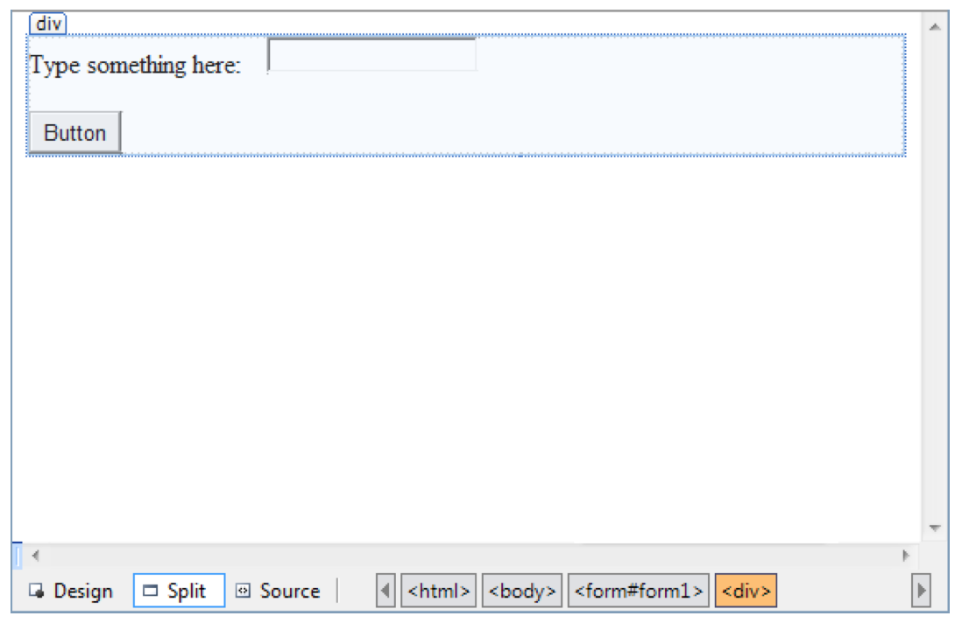
Style Builder/CSS Properties Window
In the design window, click somewhere inside the <div> (but not on another control). You’ll know you’re in the right spot when a border appears around your controls, showing you the outline of the <div>

Slide 10
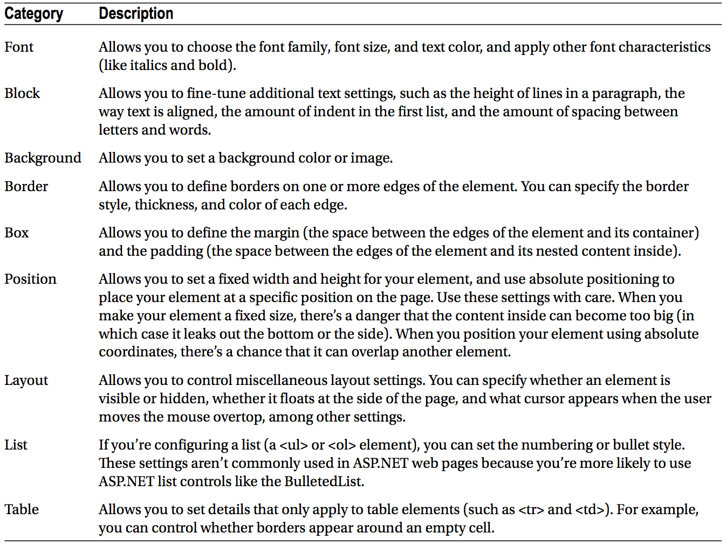
Style Settings

Slide 11
Creating a Style Sheet
To create a style sheet in Visual Studio, choose Website Add New Item from the Visual Studio menu. Then, pick the Style Sheet template, specify a file name (like StyleSheet.css), and click Add.
.heading1
{
font-weight: bold;
font-size: large;
color: limegreen;
font-family: Verdana, Arial, Sans-Serif;
}

Slide 12
Themes
The problem is that CSS rules are limited to a fixed set of style attributes.
They allow you to reuse specific formatting details (fonts, borders, foreground and background colors, and so on), but they obviously can’t control other aspects of ASP.
The themes feature fills this gap. Like CSS, themes allow you to define a set of style details that you can apply to controls in multiple pages. However, unlike CSS, themes aren’t implemented by the browser. Instead, ASP.NET processes your themes when it creates the page.

Slide 13
How Themes Work
All themes are application specific.
To use a theme in a web application, you need to create a folder that defines it.
This folder needs to be placed in the App_Themes folder, which must be placed inside the top-level directory for your web application.
To actually make your theme accomplish anything, you need to create at least one skin file in the theme folder. A skin file is a text file with the .skin extension.

Slide 14
Styling only with properties
<asp:ListBox runat="server" ForeColor="White" BackColor="Orange"/>

Slide 15
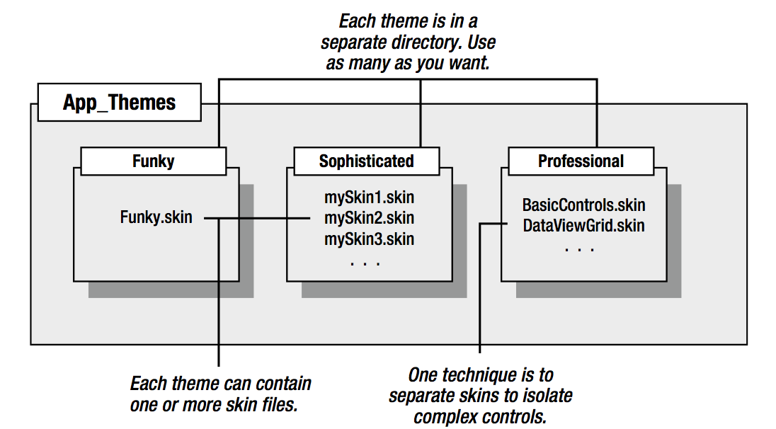
Themes and skins for an app

Slide 16
Applying a Simple Theme
To add a theme to your project, select Website Add New Item, and choose Skin File. Visual Studio will warn you that skin files need to be placed in a subfolder of the App_Themes folder and ask you whether that’s what you intended. If you choose Yes, Visual Studio will create a folder with the same name as your theme file.

Slide 17
Sample
Skin File
<asp:ListBox runat="server" ForeColor="White" BackColor="Orange"/>
<asp:TextBox runat="server" ForeColor="White" BackColor="Orange"/>
<asp:Button runat="server" ForeColor="White" BackColor="Orange"/>
Page file:
<%@ Page Language="C#" AutoEventWireup="true" ... Theme="FunkyTheme" %>

Slide 18
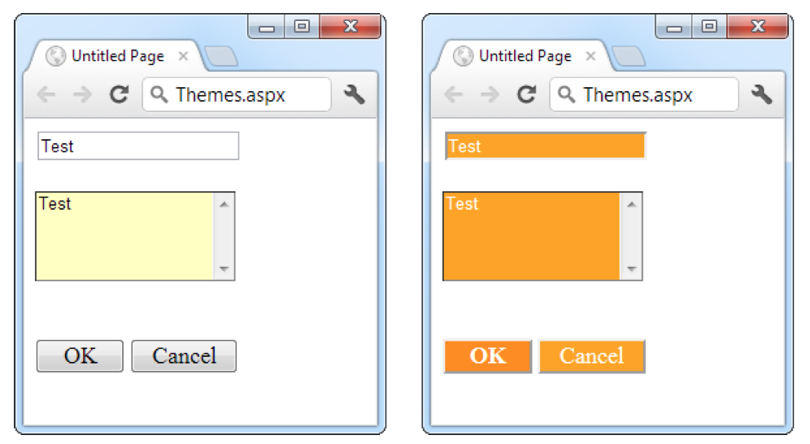
Example

Slide 19
Applying a theme to an entire website
Configure the <pages> element in the web.config file for your application, as shown here:
<configuration>
<system.web>
<pages theme="FunkyTheme">
...
</pages>
</system.web>
</configuration>

Slide 20
Apply a theme without overwriting conflicting properties
<configuration>
<system.web>
<pages styleSheetTheme="FunkyTheme">
...
</pages>
</system.web>
</configuration>

Slide 21
Master Page Basics
The best websites don’t look like a series of web pages; instead, they give the illusion of a continuously running application.
What if you want a navigation bar on every web page? Not only do you need to copy the same user interface markup to each page, but you also need to make sure it ends up in the same place. An offset of a couple of pixels will completely ruin the illusion, making it obvious that the pages aren’t really integrated.
Frames are an HTML feature that lets the browser show more than one web page alongside another. Unfortunately, frames have problems of their own, including that each frame is treated as a separate document and requested separately by the browser.

Slide 22
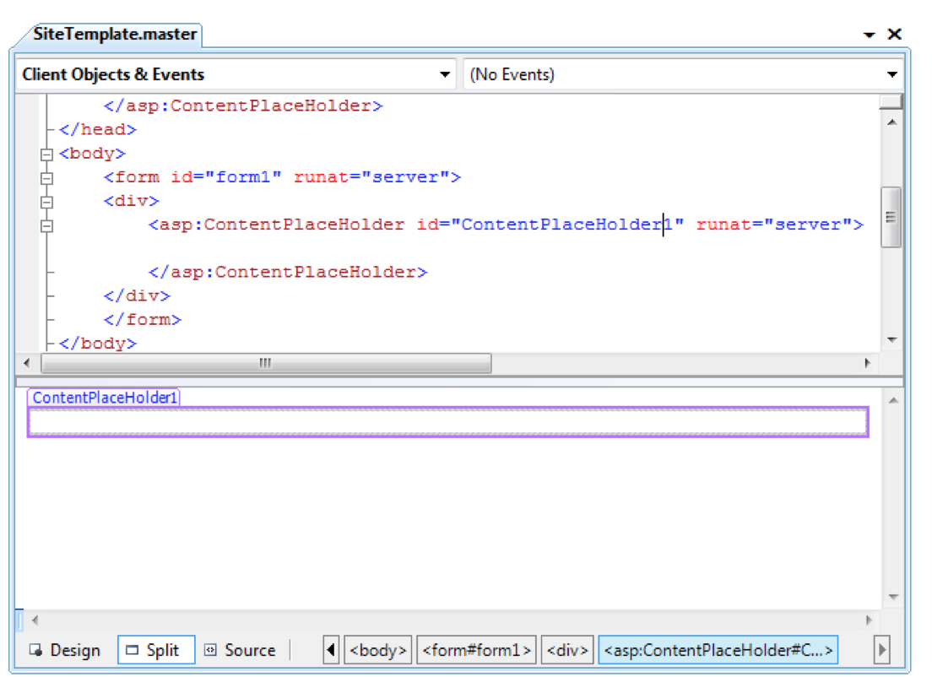
A Simple Master Page and Content Page

Slide 23
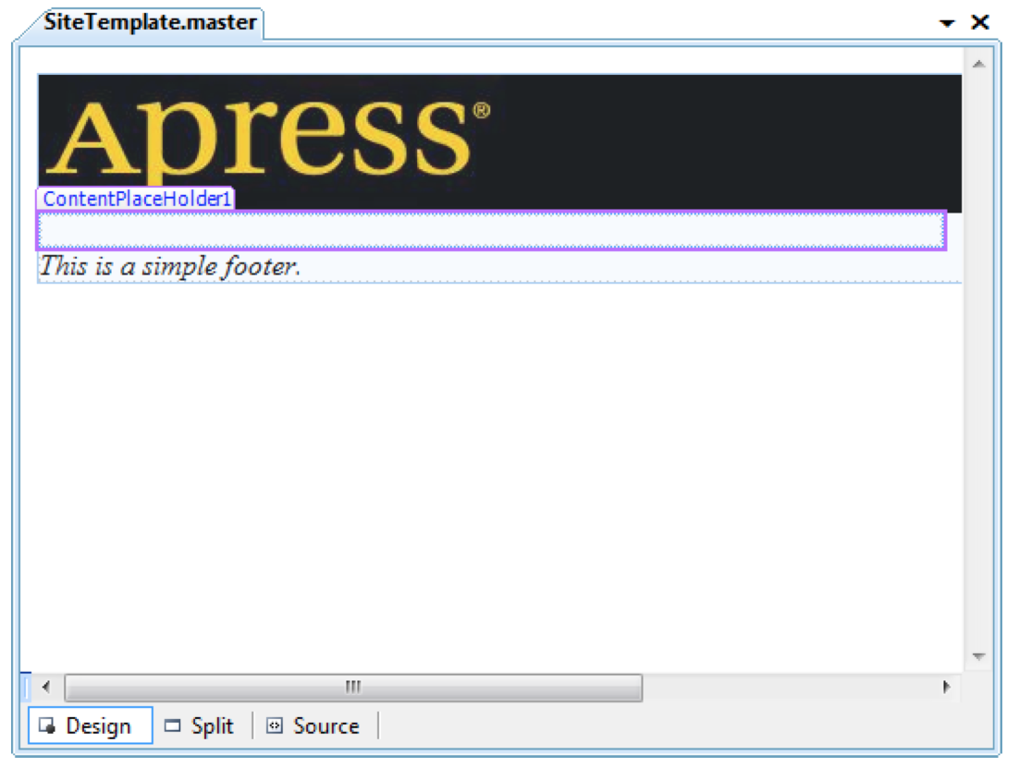
A simple master page with a header and footer

Slide 24
How Master Pages and Content Pages Are Connected
<%@ Master Language="C#" AutoEventWireup="true" CodeFile="SiteTemplate.master.cs" Inherits="SiteTemplate" %>

